Slide 1



A CENTER FOR INTER-DISCIPLINARY RESEARCH
2018-19
SALESMAX
SUPERVISED BY
J.B.V Prasad Raju
B.S.V.S Anoop
GOKARAJU RANGARAJU
INSTITUTE OF ENGINEERING AND TECHNOLOGY
AUTONOMOUS

Slide 2
Advanced Academic Center
( A Center For Inter-Discilinary Research )
This is to certify that the project titled
SALESMAX
is a bonafide work carried out by the following students in partial fulfilment of the requirements for Advanced Academic Center intern, submitted to the chair, AAC during the academic year _____________________
NAME | ROLL NO. | BRANCH
D Sai Rakesh Reddy | 18241A05J6 | CSE
K Shreya Reddy | 18241A05K7 | CSE
This work was not submitted or published earlier for any study
Dr ./Ms./Mr.
Dr.B.R.K.Reddy
Program Coordinator
Dr.Ramamurthy Suri
Associate Dean,AAC
Project Supervisor

Slide 3

ACKNOWLEDGEMENTS
We express our deep sense of gratitude to our respected Director , Gokaraju Rangaraju Institute of Engineering and Technology for the valuable guidance and for permitting us to carry out this project.
With immense pleasure, we record our deep sense of gratitude to our respected principal, for permitting us to carry out this project.
We are thankful to Associate Dean ,Advanced Academic Centre for providing us appropriate ecosystem required for the project to complete.
We are thankful to our project supervisor's, J.B.S.V Prasad Raju and B.S.V Anoop who spared valuable time for us and influence novel ideas to guide us. I am indebted to all the above without whom I would not have concluded the project.

Slide 4
ABSTRACT
MACHINE LEARNING, boosting technology of this era which is taking its place in every field. There are many problems that are historically very easy for humans, and very difficult for computers. Machine learning is currently our best solution for many of those problems, by far. For example, imagine you have the model that recognizes traffic signs. What if now you want to recognize different types of birds instead? With machine learning, all you have to do is retrain the model with the new dataset, and maybe tweak the architecture a bit to get optimal performance.
Here we study the usage of machine learning in prediction of supermarket sales. ML generalization can be used to make sales predictions when there is a small amount of historical data for specific sales time series in the case when a new product or store is launched.

Slide 5
TABLE OF CONTENTS
1 | Acknowledgments | iv
2 | Abstract | vii
3 | Introduction | 1
4 | Literature Review | 2
5 | Software Specification | 4
6 | Software and Implementation | 4
7 | Findings/Outcome | 6
8 | Software | 7
9 | Glossary | 12
10 | Future Scope | 13
11 | Reference | 13

Slide 6
INTRODUCTION
The importance of taking advantage of this data is continuously increasing. One of the most valuable assets a company has today is the data generated by the customers and it has become popular to try and win business benefits from analysing this data. Within the data there might be patterns that could be used to guide a company in how to take decisions regarding marketing, organization and sales.
Sales prediction is an important part of modern business intelligence. It can be a complex problem, especially in the case of lack of data, missing data, and the presence of outliers. At present time, different time series models have been developed, for example, by Holt-Winters, ARIMA, SARIMA, SARIMAX, GARCH, etc. It is shown that in the case when different models are based on different algorithms and data, one can receive essential gain in the accuracy.
Accuracy improving is essential in the cases with large uncertainty. Here are a wide range of applications where sales prediction can have an impact in the food industry and although prediction tools are used in aiding the ordering of supplies in a grocery store, there are still many areas to explore. However, machine learning has in the last decade grown to become a field with broad application potential

Slide 7
LITERATURE REVIEW
2. LITERATURE REVIEW
This Literature review deals with the problem statement in detail. This is an analytical look at the previous research that is significant to the work that is carried out. A critical look at these available literatures related to the present work is given.
2.1. MACHINE LEARNING
Machine Learning is a sub-set of artificial intelligence where computer algorithms are used to autonomously learn from data and information. In machine learning computers don’t have to be explicitly programmed but can change and improve their algorithms by themselves.
Today, machine learning algorithms enable computers to communicate with humans, autonomously drive cars, write and publish sport match reports, and find terrorist suspects.
It all started in 1950’s when Alan Turing creates the “Turing Test” to determine if a computer has real intelligence. To pass the test, a computer must be able to fool a human into believing it is also human.

Slide 8
1952 — Arthur Samuel wrote the first computer learning program. The program was the game of checkers, and the IBM computer improved at the game the more it played, studying which moves made up winning strategies and incorporating those moves into its program.
1957 — Frank Rosenblatt designed the first neural network for computers, which simulate the thought processes of the human brain.
1967 — the “nearest neighbour” algorithm was written, allowing computers to begin using very basic pattern recognition.

Slide 9
SOFTWARE SPECIFICATION
Python
Jupyter
SOFTWARE AND IMPLEMENTATION
Sales prediction is rather a regression problem than a time series problem. We can find complicated patterns in the sales dynamics, using supervised machine-learning methods. Some of the most popular are tree-based machine-learning algorithms , e.g., Random Forest, Gradient Boosting Machine written in python or R.
We have collected product data of the largest store BIG MART from the year 2013. An estimated 1559 products of 10 different stores in various cities were collected. Using this data the predictive model will be trained. This is achieved by five steps:
1. Exploring Data. 2. Data Pre-processing. 3. Feature Engineering. 4. Creating Model. 5. Evaluation.

Slide 10
In the sales data, we will observe several types of patterns and effects. They are: trend, seasonality, autocorrelation, patterns caused by the impact of such external factors as promo, pricing, competitors’ behaviour. To overcome all these we are using four algorithms:
Linear Regression
Ridge Regression
Design tree
Random Forest
The calculations are conducted in the Python environment using the main packages pandas, sklearn, numpy, keras, matplotlib, seaborn. To conduct the analysis, Jupyter Notebook is used. Two files are used train the model i.e., TRAIN file and TEST file. They have 12 columns from which independent variables like output_outlet, output_location, etc. are considered for prediction.
CODE:

Slide 11
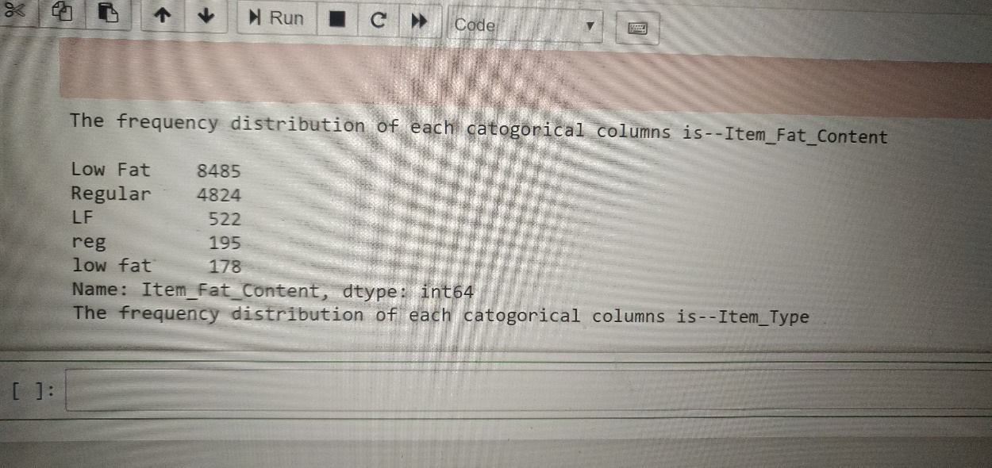
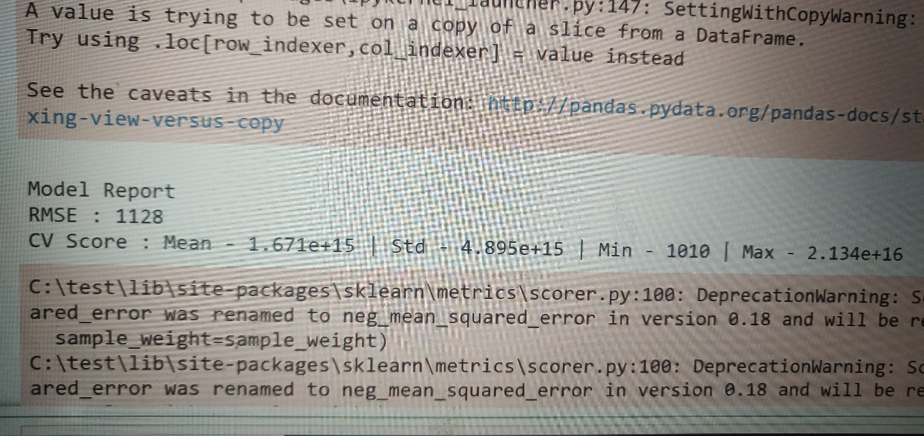
FINDINGS/OUTCOME
By running the code we have achieved frequencies of various independent variables , RSME, MSE

Slide 12
CODE:
#Importing the libraries required
import pandas as pd
#import numpy as np
train=pd.read_csv("train.csv",na_values={"Item_Visibility":[0]})
test=pd.read_csv("test.csv",na_values={"Item_Visibility":[0]})
train['source']='train'
test['source']='test'
data=pd.concat([train,test],ignore_index=True)
#the one thing we have to focus is item_outlet_Sales
discpt=data.describe()
#Lets find out how many zero'es values are
nan_descript=data.apply(lambda x: sum(x.isnull()))
#Now lets find out the unique values in each of the catogorical columns
uniq=data.apply(lambda x: len(x.unique()))

Slide 13
#let do grouping in each catogorical columns
col=["Item_Fat_Content","Item_Type","Outlet_Location_Type","Outlet_Size"]
for i in col:
print("The frequency distribution of each catogorical columns is--" + i+"\n")
print(data[i].value_counts())
#Replacing the minimum nan values in the Item_Weight with its mean value
data.fillna({"Item_Weight":data["Item_Weight"].mean()},inplace=True)
#checking the current status of nan values in the dataframe
nan_descript=data.apply(lambda x: sum(x.isnull()))
#Now we have 0 nan valuesin Item_Weight
data["Outlet_Size"].fillna(method="ffill",inplace=True)
nan_descript=data.apply(lambda x: sum(x.isnull()))
#Now working on the item_visibility
visibilty_avg=data.pivot_table(values="Item_Visibility",index="Item_Identifier")
itm_visi=data.groupby('Item_Type')
data_frames=[]
for item,item_df in itm_visi:
data_frames.append(itm_visi.get_group(item))

Slide 14
for i in data_frames:
i["Item_Visibility"].fillna(value=i["Item_Visibility"].mean(),inplace=True)
i["Item_Outlet_Sales"].fillna(value=i["Item_Outlet_Sales"].mean(),inplace=True)
new_data=pd.concat(data_frames)
nan_descript=new_data.apply(lambda x: sum(x.isnull()))
#Now we have successfully cleaned our complete dataset.
new_data["Item_Fat_Content"].replace({'LF':'Low Fat','reg':'Regular','low fat':'Low Fat'},inplace=True)
new_data["Item_Fat_Content"].value_counts()
#Implementing one-hot-Coding method for getting the categorical variables
from sklearn.preprocessing import LabelEncoder
le = LabelEncoder()
data=new_data
data['Outlet'] = le.fit_transform(data['Outlet_Identifier'])
var_mod = ['Item_Fat_Content','Outlet_Location_Type','Outlet_Size','Item_Type','Outlet_Type']
le = LabelEncoder()
for i in var_mod:
data[i] = le.fit_transform(data[i])

Slide 15
#One Hot Coding:
data = pd.get_dummies(data, columns=['Item_Fat_Content','Outlet_Location_Type','Outlet_Size','Outlet_Type',
'Item_Type'])
#Exporting the datas
train = data.loc[data['source']=="train"]
test = data.loc[data['source']=="test"]
#Drop unnecessary columns:
test.drop(['Item_Outlet_Sales','source'],axis=1,inplace=True)
#here we are droping the "Item_Outlet_Sales because this only we want to be predicted from the model that we are going to built
train.drop(['source'],axis=1,inplace=True)
#Export files as modified versions:
train.to_csv("train_modified.csv",index=False)
test.to_csv("test_modified.csv",index=False)
#Let's start building the baseline model as it is non -predicting model and also commenly known as informed guess
#Mean based:
mean_sales = train['Item_Outlet_Sales'].mean()

Slide 16
#Define a dataframe with IDs for submission:
base1 = test[['Item_Identifier','Outlet_Identifier']]
base1['Item_Outlet_Sales'] = mean_sales
#Export submission file
base1.to_csv("alg0.csv",index=False)
#Define target and ID columns:
target = 'Item_Outlet_Sales'
IDcol = ['Item_Identifier','Outlet_Identifier']
''' Now from this I have to learn machine learning data_Analytics'''
import numpy as np
from sklearn import cross_validation, metrics
def modelfit(alg, dtrain, dtest, predictors, target, IDcol, filename):
#Fit the algorithm on the data
alg.fit(dtrain[predictors], dtrain[target])
#Predict training set:
dtrain_predictions = alg.predict(dtrain[predictors])
#Perform cross-validation:
cv_score = cross_validation.cross_val_score(alg, dtrain[predictors], dtrain[target], cv=20, scoring='mean_squared_error')
cv_score = np.sqrt(np.abs(cv_score))

Slide 17
#Define a dataframe with IDs for submission:
base1 = test[['Item_Identifier','Outlet_Identifier']]
base1['Item_Outlet_Sales'] = mean_sales
#Export submission file
base1.to_csv("alg0.csv",index=False)
#Define target and ID columns:
target = 'Item_Outlet_Sales'
IDcol = ['Item_Identifier','Outlet_Identifier']
''' Now from this I have to learn machine learning data_Analytics'''
import numpy as np
from sklearn import cross_validation, metrics
def modelfit(alg, dtrain, dtest, predictors, target, IDcol, filename):
#Fit the algorithm on the data
alg.fit(dtrain[predictors], dtrain[target])
#Predict training set:
dtrain_predictions = alg.predict(dtrain[predictors])
#Perform cross-validation:
cv_score = cross_validation.cross_val_score(alg, dtrain[predictors], dtrain[target], cv=20, scoring='mean_squared_error')
cv_score = np.sqrt(np.abs(cv_score))

Slide 18
#Print model report:
print ("\nModel Report")
print ("RMSE : %.4g" % np.sqrt(metrics.mean_squared_error(dtrain[target].values, dtrain_predictions)))
print ("CV Score : Mean - %.4g | Std - %.4g | Min - %.4g | Max - %.4g" % (np.mean(cv_score),np.std(cv_score),np.min(cv_score),np.max(cv_score)))
#Predict on testing data:
dtest[target] = alg.predict(dtest[predictors])
#Export submission file:
IDcol.append(target)
submission = pd.DataFrame({ x: dtest[x] for x in IDcol})
submission.to_csv(filename, index=False)
#Liner Regression model
print("Creating the models and processing")
from sklearn.linear_model import LinearRegression, Ridge
predictors = [x for x in train.columns if x not in [target]+IDcol]
# print predictors
alg1 = LinearRegression(normalize=True)
modelfit(alg1, train, test, predictors, target, IDcol, 'alg1.csv')
coef1 = pd.Series(alg1.coef_, predictors).sort_values()
coef1.plot(kind='bar', title='Model Coefficients')

Slide 19
#Ridge Regression Model
predictors = [x for x in train.columns if x not in [target]+IDcol]
alg2 = Ridge(alpha=0.05,normalize=True)
modelfit(alg2, train, test, predictors, target, IDcol, 'alg2.csv')
coef2 = pd.Series(alg2.coef_, predictors).sort_values()
coef2.plot(kind='bar', title='Model Coefficients')
print("Model has been successfully created and trained. The predicted result is in alg2.csv")
# Decision Tree Model
from sklearn.tree import DecisionTreeRegressor
predictors = [x for x in train.columns if x not in [target]+IDcol]
alg3 = DecisionTreeRegressor(max_depth=15, min_samples_leaf=100)
modelfit(alg3, train, test, predictors, target, IDcol, 'alg3.csv')
coef3 = pd.Series(alg3.feature_importances_, predictors).sort_values(ascending=False)
coef3.plot(kind='bar', title='Feature Importances')
print("Model has been successfully created and trained. The predicted result is in alg3.csv")

Slide 20
#Random Forest Model
from sklearn.ensemble import RandomForestRegressor
predictors = [x for x in train.columns if x not in [target]+IDcol]
alg5 = RandomForestRegressor(n_estimators=200,max_depth=5, min_samples_leaf=100,n_jobs=4)
modelfit(alg5, train, test, predictors, target, IDcol, 'alg5.csv')
coef5 = pd.Series(alg5.feature_importances_, predictors).sort_values(ascending=False)
coef5.plot(kind='bar', title='Feature Importances')
print("Model has been successfully created and trained. The predicted result is in alg5.csv")
predictors = [x for x in train.columns if x not in [target]+IDcol]
alg6 = RandomForestRegressor(n_estimators=400,max_depth=6, min_samples_leaf=100,n_jobs=4)
modelfit(alg6, train, test, predictors, target, IDcol, 'alg6.csv')
coef6 = pd.Series(alg6.feature_importances_, predictors).sort_values(ascending=False)
coef6.plot(kind='bar', title='Feature Importances')
print("Model has been successfully created and trained. The predicted result is in alg6.csv")

Slide 21
SOFTWARE
To predict outcomes of a future event a machine learning model is exposed to data from which it learns patterns that are used to predict the outcome. There are several methods for this purpose and studies have shown promising results. We use algorithms written in python/R.
5.1. Python
Python is an interpreted, high-level, general-purpose programming language. Created by Guido van Rossum and first released in 1991, Python's design philosophy emphasizes code readability with its notable use of significant whitespace. Its language constructs and object-oriented approach aim to help programmers write clear, logical code for small and large-scale projects.
5.2. R
R is a programming language developed by Ross Ihaka and Robert Gentleman in 1993. R possesses an extensive catalog of statistical and graphical methods. It includes machine learning algorithm, linear regression, time series, statistical inference to name a few. Most of the R libraries are written in R, but for heavy computational task, C, C++ and Fortran codes are preferred.
.

Slide 22
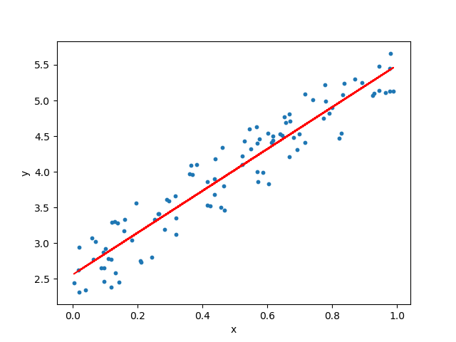
5.3 ALGORITHMS
5.3.1 Linear Regression
In statistics, linear regression is a linear approach to modeling the relationship between a scalar response (or dependent variable) and one or more explanatory variables (or independent variable). In linear regression, the relationships are modeled using linear predictor functions whose unknown model parameters are estimated from the data. Such models are called linear models. Linear regression was the first type of regression analysis to be studied rigorously, and to be used extensively in practical applications. This is because models which depend linearly on their unknown parameters are easier to fit than models which are non-linearly related to their parameters and because the statistical properties of the resulting estimators are easier to determine.

Slide 23
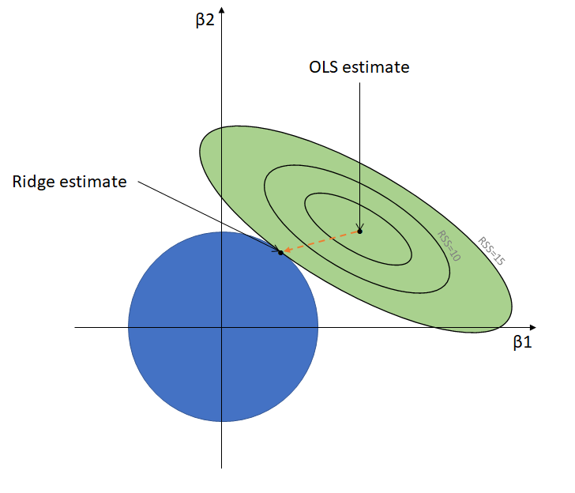
5.3 ALGORITHMS
5.3.2 Ridge Regression
Ridge Regression is a technique for analyzing multiple regression data that suffer from multicollinearity. When multicollinearity occurs, least squares estimates are unbiased, but their variances are large so they may be far from the true value. By adding a degree of bias to the regression estimates, ridge regression reduces the standard errors. It is hoped that the net effect will be to give estimates that are more reliable. Another biased regression technique, principal components regression. Ridge regression is the more popular of the two methods.
Following the usual notation, suppose our regression equation is written in matrix form as
Y = XB + e
where Y is the dependent variable, X represents the independent variables, B is the regression coefficients to be estimated, and e represents the errors are residuals.

Slide 24
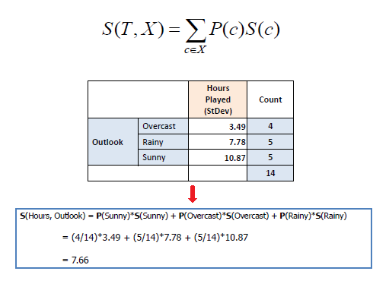
5.3 ALGORITHMS
5.3.3 Decision Tree Model
Decision tree builds regression or classification models in the form of a tree structure. It breaks down a dataset into smaller and smaller subsets while at the same time an associated decision tree is incrementally developed. The final result is a tree with decision nodes and leaf nodes. A decision node (e.g., Outlook) has two or more branches (e.g., Sunny, Overcast and Rainy), each representing values for the attribute tested. Leaf node (e.g., Hours Played) represents a decision on the numerical target. The topmost decision node in a tree which corresponds to the best predictor called root node. Decision trees can handle both categorical and numerical data. The core algorithm for building decision trees called ID3 by J. R. Quinlan which employs a top-down, greedy search through the space of possible branches with no backtracking. The ID3 algorithm can be used to construct a decision tree for regression by replacing Information Gain with Standard Deviation Reduction.

Slide 25
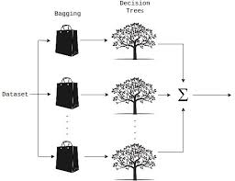
5.3 ALGORITHMS
5.3.4 Random Forest Model
A random forest is a meta estimator that fits a number of classifying decision trees on various sub-samples of the dataset and uses averaging to improve the predictive accuracy and control over-fitting. The sub-sample size is always the same as the original input sample size but the samples are drawn with replacement if bootstrap=True (default). As part of their construction, random forest predictors naturally lead to a dissimilarity measure among the observations. One can also define a random forest dissimilarity measure between unlabeled data: the idea is to construct a random forest predictor that distinguishes the “observed” data from suitably generated synthetic data. A random forest dissimilarity can be attractive because it handles mixed variable types very well, is invariant to monotonic transformations of the input variables, and is robust to outlying observations.

Slide 26
GLOSSARY
MSE: The average of the squared error that is used as the loss function for least squares regression.
Linear Regression: It is a machine learning algorithm based on supervised learning.
Pandas: It offers data structures and operations for manipulating numerical tables and time series.
Numpy: Adds support for large, multi-dimensional arrays and matrices, along with a large collection of high-level mathematical functions to operate on these arrays
Adjusted R^2: It is a statistical measure that shows the proportion of variation explained by the estimated regression line.
Standard Mean Reduction: Standard deviation is a number used to tell how measurements for a group are spread out from the average (mean), or expected value.
Gradient Boosting: It allows for the optimization of arbitrary differentiable loss functions. In each stage a regression tree is fit on the negative gradient of the given loss function.

Slide 27
FUTURE SCOPE
The use of regression approaches for sales forecasting can often give us better results compared to time series methods. The accuracy on the validation set is an important indicator for choosing an optimal number of iterations of machine-learning algorithms. Thus, implementing this method will boost the sales and profits.
REFERENCES
Mentzer, J.T.; Moon, M.A.Sales Forecasting Management: A Demand Management Approach; Sage: ThousandOaks, CA, USA, 2004
Sylvain Arlot. “A survey of cross-validation procedures for modelselection”. In:Statistics Surveys4 (2010), pp. 40–79.ISSN: 1935-7516.DOI:10.1214/09-SS054.
Ching-Wu Chu and Guoqiang Peter Zhang. “A comparative studyof linear and nonlinear models for aggregate retail sales forecast-ing”. In:International Journal of Production Economics86 (January2003), pp. 217–231.
Brynjolfsson McAfee. “Big data the management revolution”. In:Harvard Business Review(October 2012), pp. 59–68.

